Slide 1
Group 5 – final project

Slide 2
Credit worthiness
The analysis aimed to determine the probability of a loan defaulting due to factors collected in the data. The team secured data from Kaggle, cleaned the dataset, built a regression model and created an interactive (HTML) user interface (UI) to get predictions. The HTML page allowed users to see the predictions of the model. The evaluation had limitations due to limitations within the data. This report outlines the limitations of the data and an overview of the analysis.

Slide 3
The analysis
The analysis is organized into the following sections:
Data
Exploration of the dataset.
Data cleaning and preparation processes.
Feature engineering to enhance predictive performance.
Machine Learning Model
Regression model used to predict loan defaults.
Evaluation metrics such as accuracy and R-squared.
Insights derived from the model.
HTML Page
Interactive interface designed to generate loan default predictions.
User-friendly layout for entering input data and viewing predictions.
Conclusion
Summary of findings and insights.
Identified limitations in the dataset.
Recommendations for improving the analysis in the future.

Slide 4
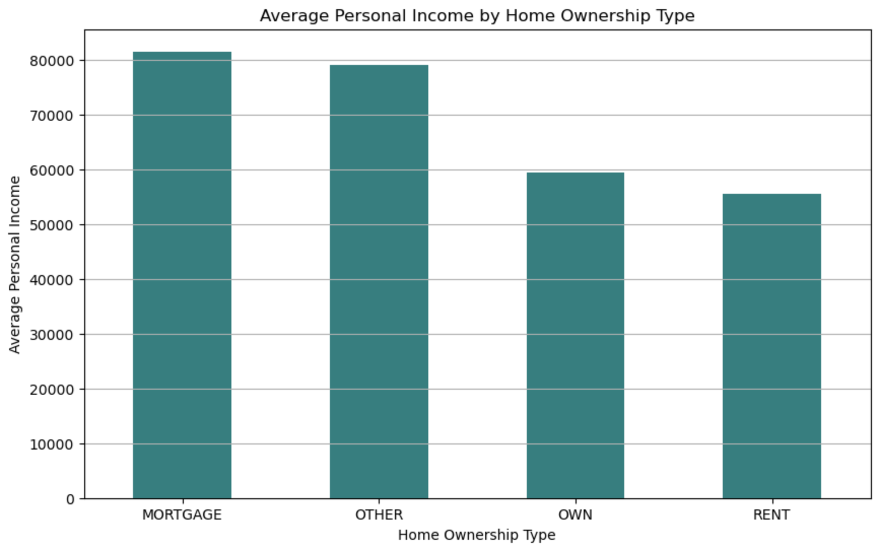
visuals

Slide 5
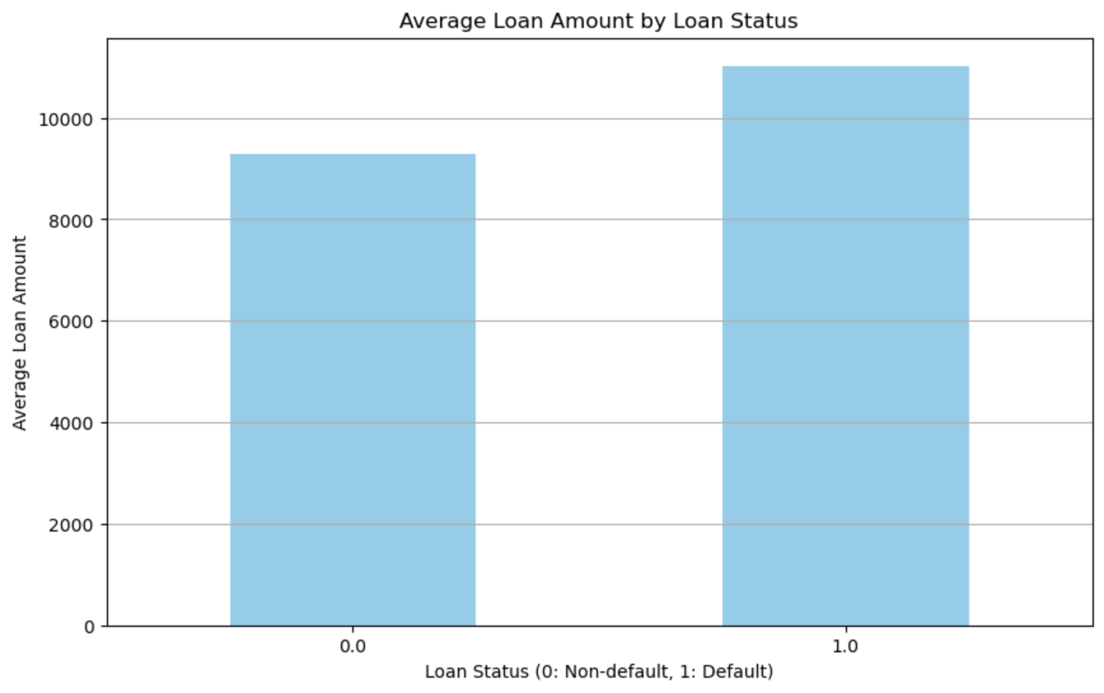
visuals

Slide 6
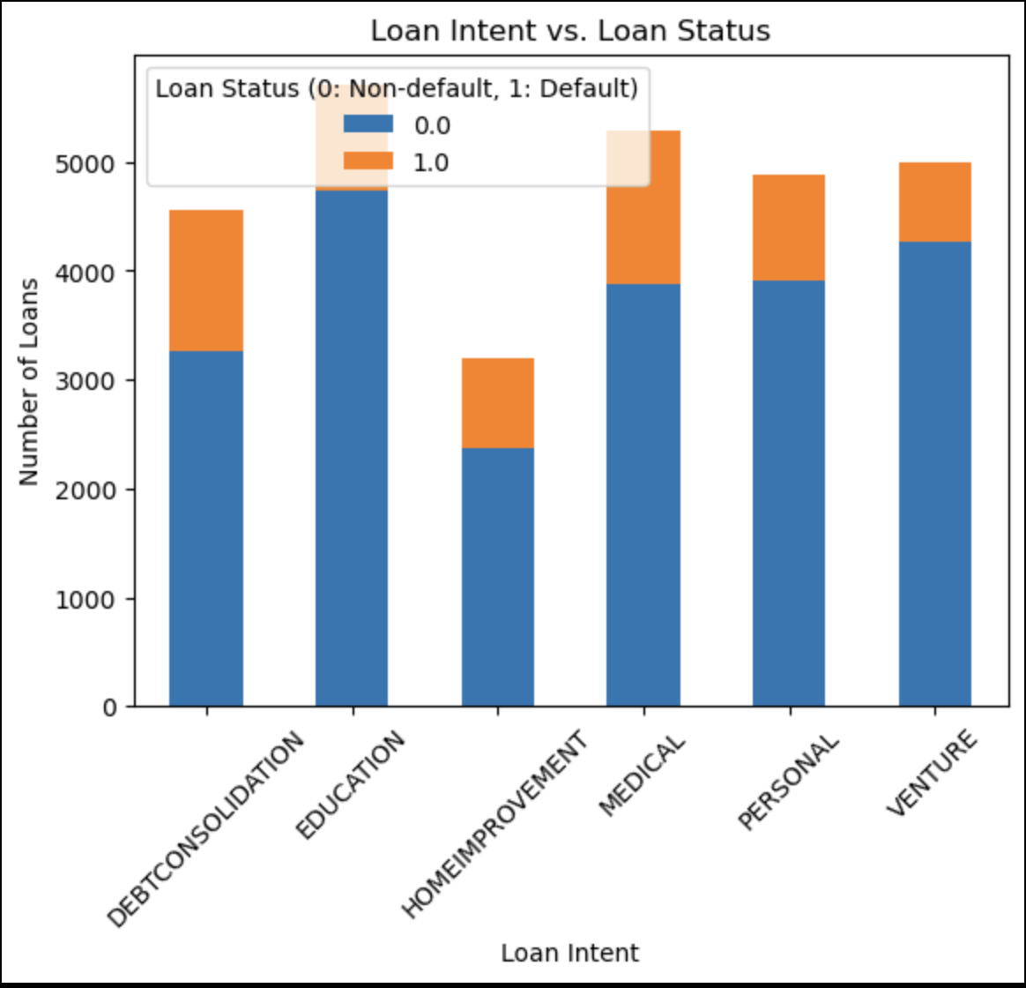
visuals

Slide 7
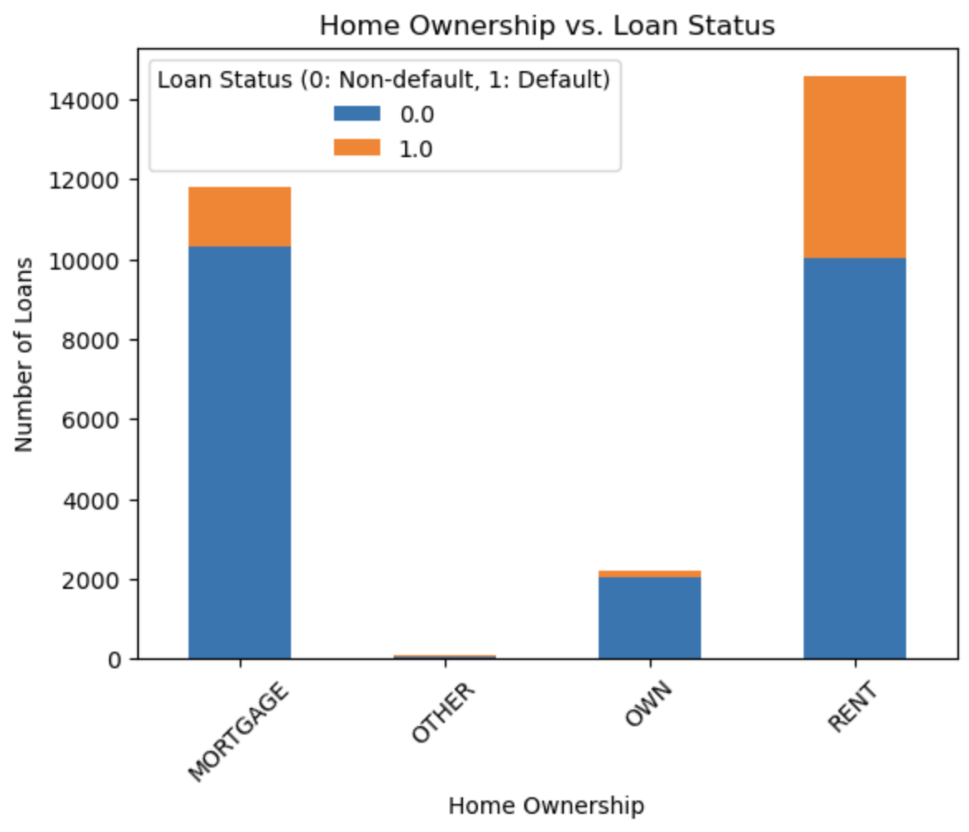
visuals

Slide 8
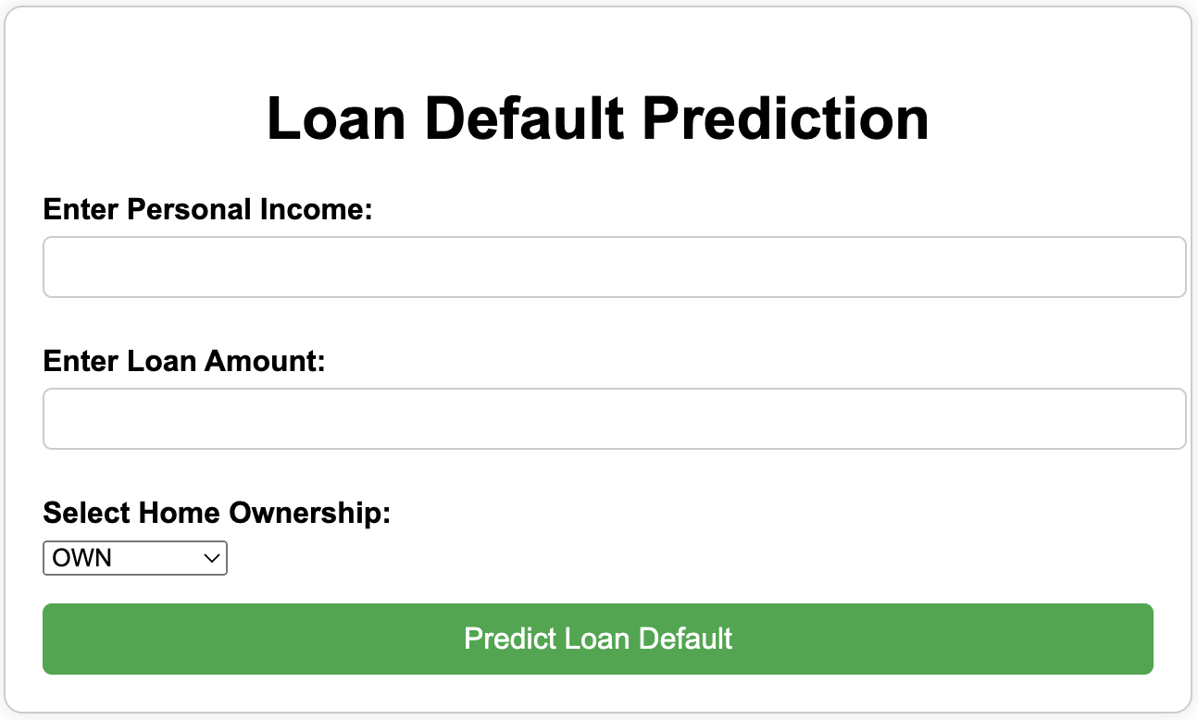
Html page

Slide 9
Thank you

